Slide 1
What lies behind public acceptance of fusion? A European Study
Christian Oltra and Ana Prades (CIEMAT, Spain)
Christopher Jones (Surrey University, UK)
EUROfusion Science Meeting on Socio-economic studies. Wednesday 9th October 2019

Slide 2

WPSES: Social research on fusion
Public Attitudes /Acceptance
Stakeholder Engagement
Media Analysis / Framing
Collaboration with COMS
What lies behind public acceptance of fusion? A European Study

Slide 3
Without public acceptance, it may be impossible for electric sector innovations to gain regulatory approval, find sites, or secure funding… Too often, though the public face of new technologies is an afterthought (Apt & Fischhof, 2006)
SES Aim:
Make the public face of fusion a forethought in the fusion RDD&D
Limited research on the public perceptions of fusion:
Very limited awareness, lack of knowledge (e.g. Prades et al., 2008)
Seen as abstract, except in siting studies (e.g. Prades et al., 2008)
Role of associations with nuclear technologies and the fission program (e.g. Horlick-Jones et al., 2012; Jones et al., 2019)

Slide 4
  How to deal with such low levels of knowledge?
  How to deal with the abstract and unfamiliar?
  How to provide information in suitably balanced ways (research task in itself )?
  How perceptions change as they learn more about the technology and associated issues?
  Key determinants of lay attitudes towards fusion?
  …
Research challenges
 | SCK-CEN (2008) | CIEMAT- Cardiff University (2009-2012) | IPPLM (2012-13) | SCK-CEN (2016-17)
Context | ITER Sitting | Abstract and unfamiliar fusion technology
Method | Focus groups RF Groups |  | Quasi experimental | Survey
Samples | Lay citizens |  | Students | Belgium Population
Findings & implications | Conceptual & methodological insights Practical implications for learning and communication processes

Slide 5
KEY FINDINGS FROM PREVIOUS RESEARCH
Limited public awareness of fusion, but public attitudes mostly favourable.
Attitude toward fusion is most strongly correlated to attitude towards nuclear energy
The influence of other predictors (attitudes towards science & technology; fusion timelines, costs; new energy technologies) differs between informed and uninformed respondents
Just good news is not good: need to embrace and engage with multiple sources of knowledge & uncertainty
Technical understanding of fusion is not a pre-condition for support: need to include wider social implications of fusion technology
Reasoning practices change as citizens learn more about the technology: need to address the nature & the stability of the changes
What lies behind public acceptance of fusion? A European Study

Slide 6

Our study
Cross-national study to investigate ‘informed’ lay-attitudes (evaluation, beliefs and affect) towards fusion energy and research in Europe
To examine determinants of lay-attitudes to fusion (values, related attitudes, socio-demographics, information provided)
Improve public consultation-engagement efforts
Contribute to improve our understanding of public acceptance of fusion energy in Europe

Slide 7
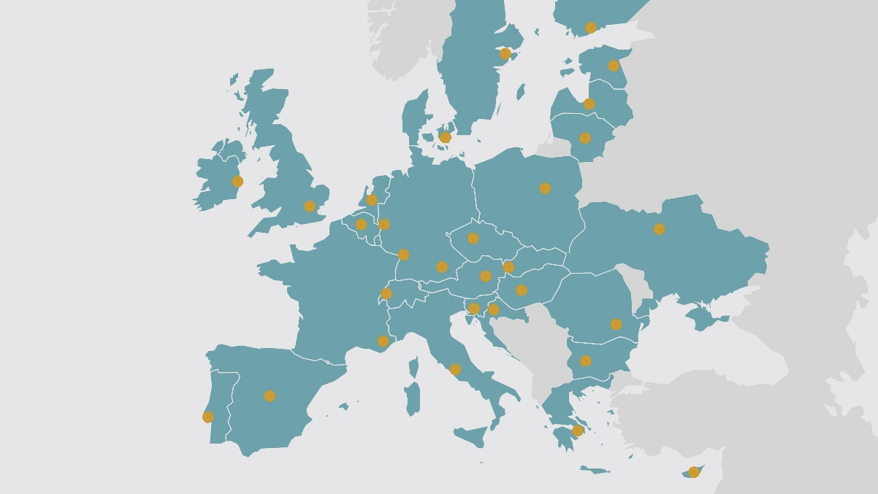
Method
A European survey of 19,970 citizens recruited from national online panels was carried out in 2018 within EUROFUSION-SES to understand Europeans’ attitudes towards fusion energy research in 21 countries.
In order to assess informed opinions of fusion energy, we provided participants with general information about fusion energy and about the potential consequences of developing fusion before asking them questions

Slide 8
Figure 1. Design of the questionnaire
Introduction to the study
Prior attitudes
Introduction to fusion energy
General information about fusión | Information about consequences of fusión | Information about stakeholder views
200 words Neutral to positive All participants | Brief information on consequences (reviewed by experts) to be evaluated by participants | Controversial information 10% of participants
Awareness and personal relevance
Background information on fusion
Initial evaluation, affects and beliefs
Information on consequences
Global evaluation, acceptance and support

Slide 9
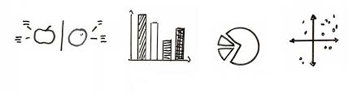
Key results

Slide 10
Notes:
We asked 19,000 citizens in Europe to evaluate fusion as an Energy option

Slide 13
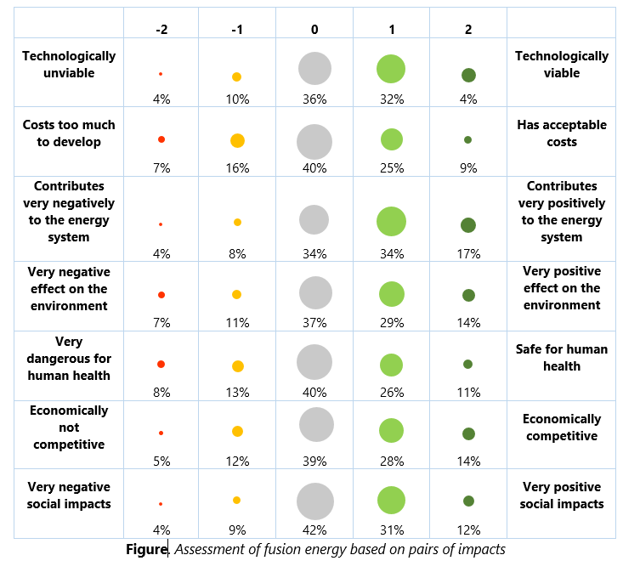
BELIEFS ABOUT THE IMPACTS OF FUSION (PREVIOUS TO INFORMATION)

Slide 14
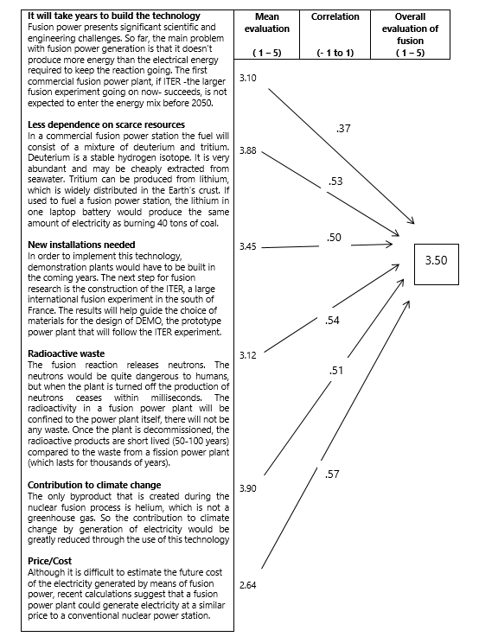
HOW PEOPLE RATE THE CONSEQUENCES OF FUSION AND HOW THIS EVALUATION IS CORRELATED WITH THE OVERALL EVALUATION OF FUSION

Slide 15
INFORMED GROUP
CONTROL GROUP

Slide 16

What about cross-national differences?

Slide 19


Three types of countries
ENTHUSIASTS
ENTHUSIAST
(Finland, Romania, Bulgary)
NEUTRAL-POSITIVE
SUPPORTIVE
(United Kingdome, Spain,
Portugal)
OPPONENTS
NOT SUPPORTIVE
(Belgium, Austria)

Slide 20

What about differences between individuals?

Slide 23
Determinants of support for fusion energy research
Personal relevance
.10
R² = .63
R² = .50
Attitude towards nuclear
Affect
.39
Trust
.60
.35
Overall Evaluation
Support
.63
Attitude towards science
.30
.62
Perceived consequences
.47
-.16
Preference for investment in renewables
PATH ANALYSIS

Slide 24
Implications
Information is important. Individuals’ beliefs about the features and likely impacts of fusion plays a critical role in support for fusion energy research
But emotions are also important
  Interest is important
  Trust is critical (determined by perceived competence, but mainly perceived empathy, honesty and dedication). But trust can be also a consequence of prior attitudes.
Personal relevance is also important. How to make it more relevant?
The overall evaluation of fusion is partially independent from beliefs and emotions. It can be partially predetermined.
Attitude towards nuclear and towards science are very important determinants of attitude towards fusion
Values and cultural orientations also matter in attitudes towards fusion

Slide 25
Thank you
Christian Oltra and Ana Prades (CIEMAT, Spain)
Christopher Jones (Surrey University, UK)
EUROfusion

Slide 26
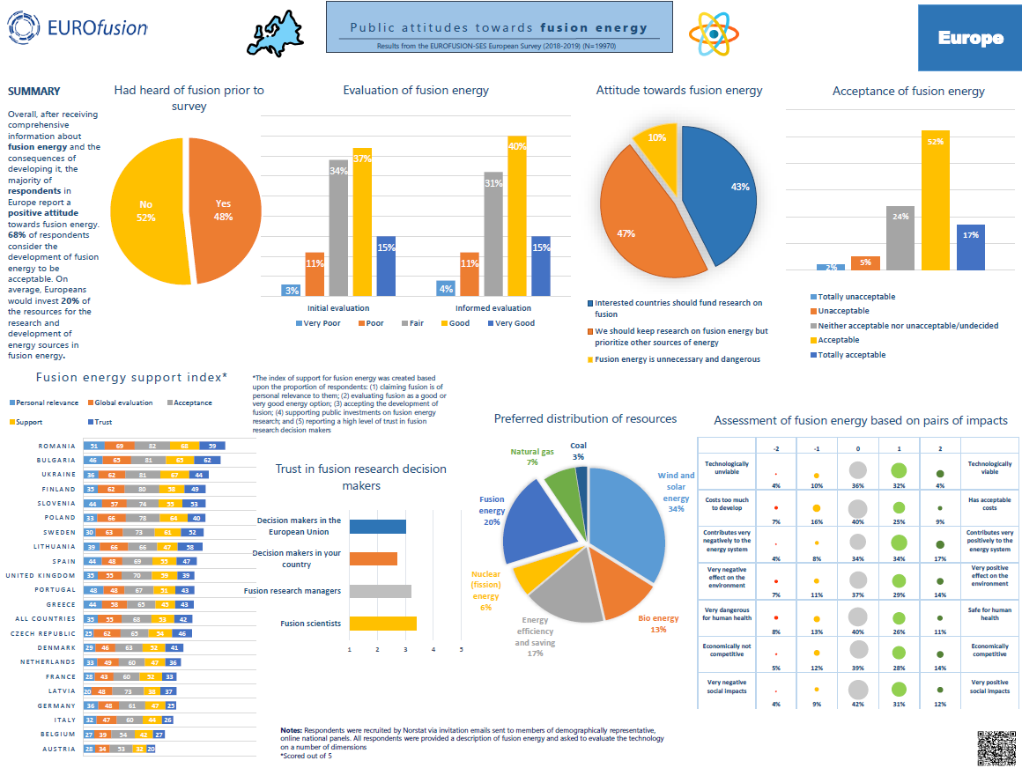

Slide 27
preferences for investment IN ENERGY OPTIONS*
AUSTRIA
FINLAND
* Participants were asked to invest 100 euros in the various Energy options
SPAIN
UNITED KINGDOM

